Slide 1

Stock market analysis
Stock Market Data Analysis Using Excel, Power BI, MySql, Tableau.

Slide 2
Group 5
Group Members :
Rahul Deepak Kadu
Vishakha Priya
Vishal Radheshyam Singh
Ansh Bachhe
Suma K T
Venkata Jeevan Kumar

Slide 3
Introduction to topic
This project focuses on analyzing stock market performance using historical trading data across multiple companies and sectors.
An interactive dashboard was developed to monitor key metrics such as market capitalization, portfolio value, trading volume, returns, volatility, and win rate.
The dashboard enables users to filter data by trader name, company name, and month, providing dynamic insights into sector-wise and company-wise performance.
The objective of this project is to support data-driven investment decisions, identify high-performing sectors, and evaluate portfolio efficiency through visual analytics.

Slide 4
Key kpi’s
Market Capitalization
Measures the overall size and market value of a company.
Indicates how the market perceives a company’s stability, growth potential, and risk.
Portfolio Volume
Represents the total amount of trading activity within your portfolio.
Reflects how actively the portfolio is being managed.
Total Volume
Measures overall trading activity in the entire market or specific assets.
Shows how much interest and participation exists.

Slide 5
Key kpi’s
Volatility
Indicates the degree of price fluctuation over time.
A direct measure of risk and uncertainty.
Trade Win Rate
Percentage of trades that are profitable.
Measures strategy effectiveness, not profitability alone.
Sector And Companie’s Daily Return
Measures short-term performance at both sector and company levels.
Highlights relative strength and weakness.

Slide 6
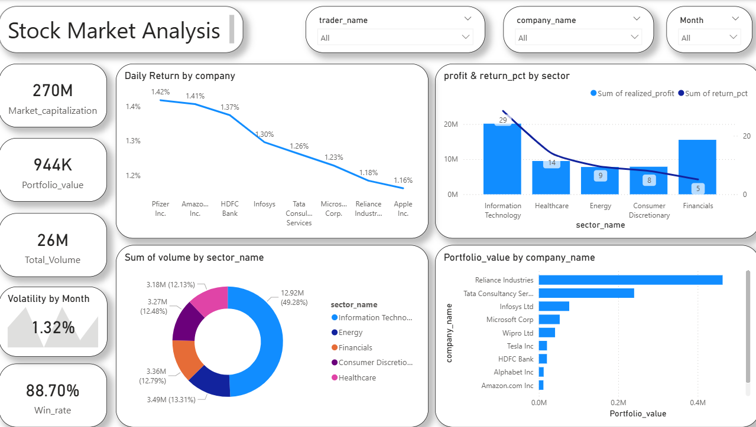
Power BI Dashboard

Slide 7
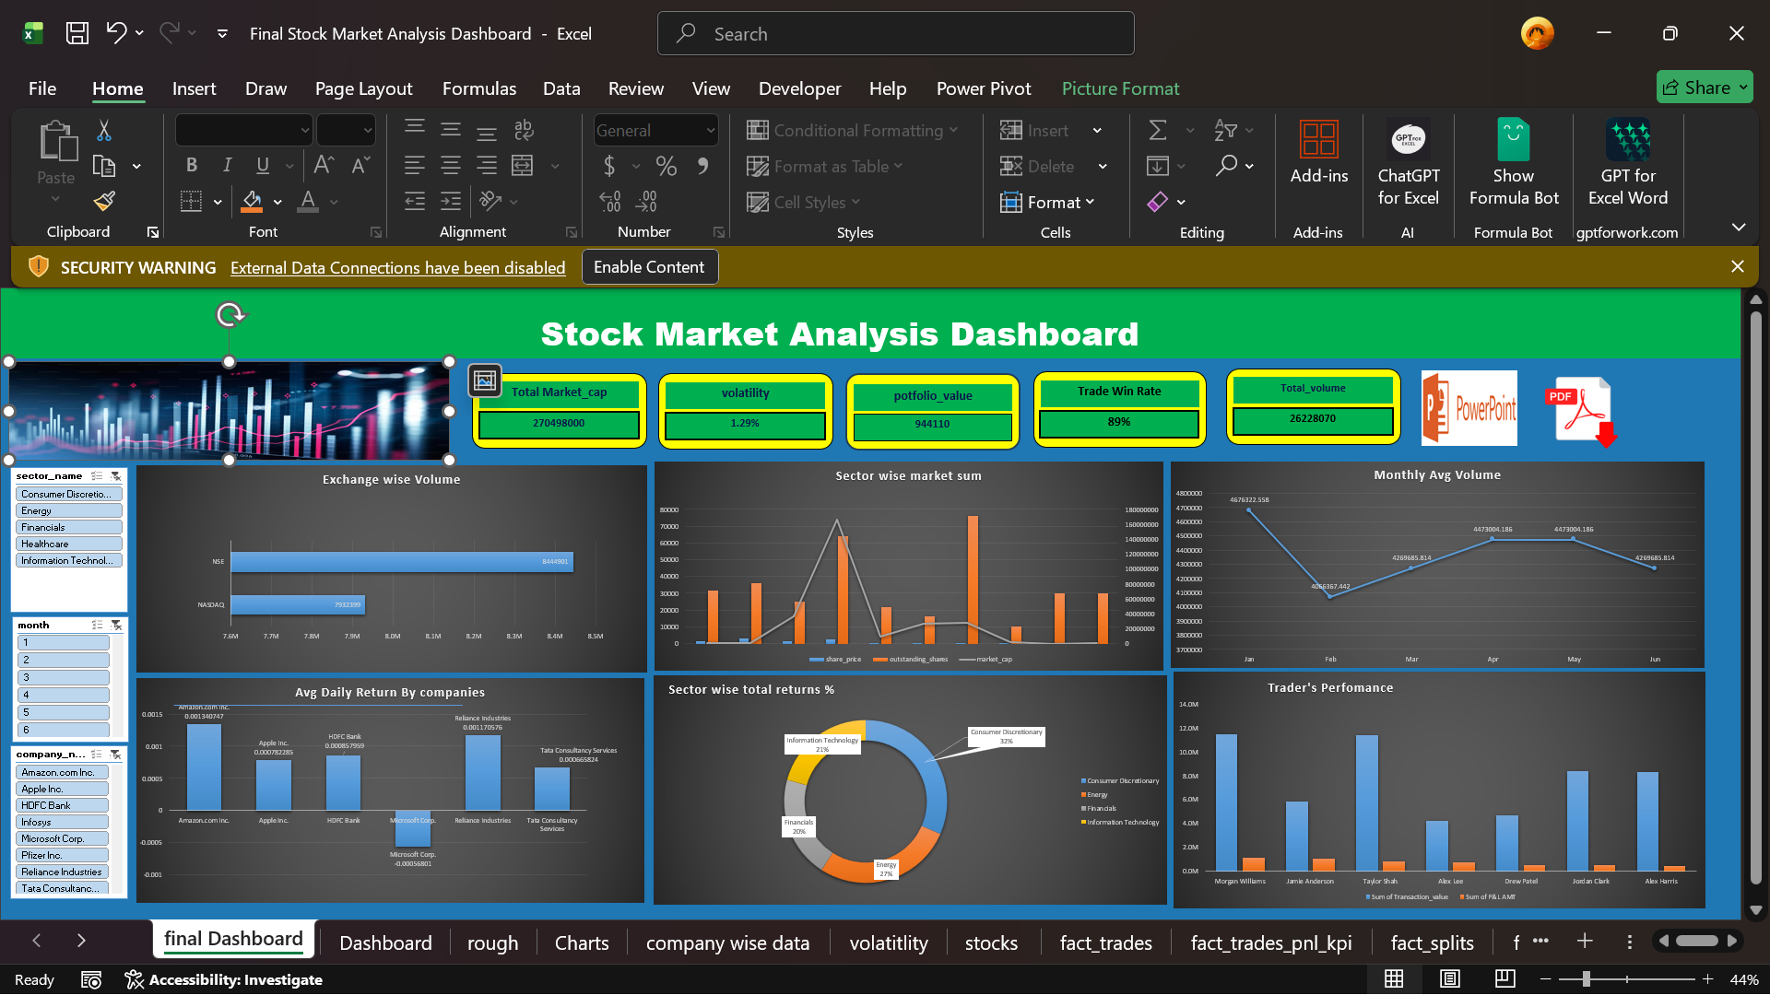
Excel Dashboard

Slide 8
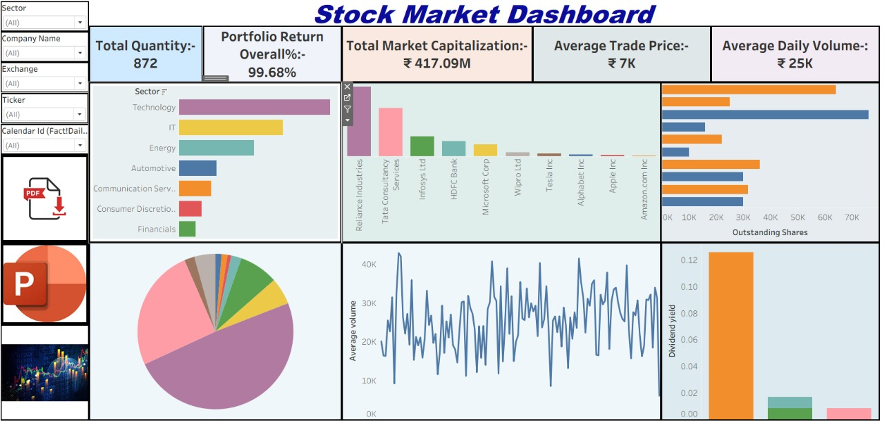
Tableau Dashboard

Slide 9
Key insights
1. Overall Portfolio Performance
The total market capitalization stands at 270M
The portfolio value is 944K.
A high win rate of 88.7% suggests effective trading strategies and successful stock selection.
Average volatility of 1.32%
2. Company-wise Return Analysis
Companies like Pfizer Inc. and Amazon Inc. show higher daily returns (~1.4%).
Apple Inc. and Reliance Industries have comparatively lower daily returns, indicating slower growth during the analyzed period.
This highlights variation in short-term performance across companies.

Slide 10
Key insights
3. Sector-wise Profit & Return
Information Technology sector generates the highest realized profit and return percentage.
Healthcare and Energy sectors show moderate performance.
Financials sector has lower return percentages, suggesting underperformance compared to other sectors.
4. Trading Volume Distribution
Nearly 50% of total trading volume comes from the Information Technology sector, showing strong investor interest.
Other sectors such as Energy, Financials, Consumer Discretionary, and Healthcare have relatively balanced but lower volumes.
5. Portfolio Value by Company
Reliance Industries holds the highest portfolio value, followed by Tata Consultancy Services and Infosys Ltd.
Companies like Amazon, Alphabet, and HDFC Bank have smaller portfolio allocations, indicating conservative exposure.

Slide 11
Suggestions
Increase Exposure to High-Performing Sectors
Reduce exposure to high volatility stocks.
Increase trading activity in high-volume month
Monitor Volatility Trends

Slide 12

THANK YOU

